Slide 1
Doctor Evidence (DRE) Introductory Training
January 2018

Slide 2
Objectives
Review the DRE-Sanofi engagement and available products/services
Understand the methodologies and technologies that power the Doctor Evidence Technology platforms:
DOC Search
DOC Library
DOC Data
Learn how to search, monitor, and analyze available literature with DOC Search
Review how to initiate a project

Slide 3
Doctor Evidence Overview
The mission of Doctor Evidence (DRE) is to find, structure, synthesize, and analyze medical data from various sources into fit-to-purpose actionable knowledge.
DRE partners with all types of healthcare stakeholders to identify and synthesize published information for informed decision-making.
Our software-service model provides the most timely and relevant evidence and analytics – for accessibility, defensibility, and agility.

Slide 4
DRE Products and Services
Identify relevant published literature to answer scientific questions and extract data from these sources using proprietary software technologies
Create curated and searchable libraries
Create relational databases suitable for analyses
Consult with our clients to provide meaningful insights that inform decisions and guide tactics
Structured consulting process
Frequent and regular touchpoints with our clients
Deliverables include written reports, slide decks and publications

Slide 5
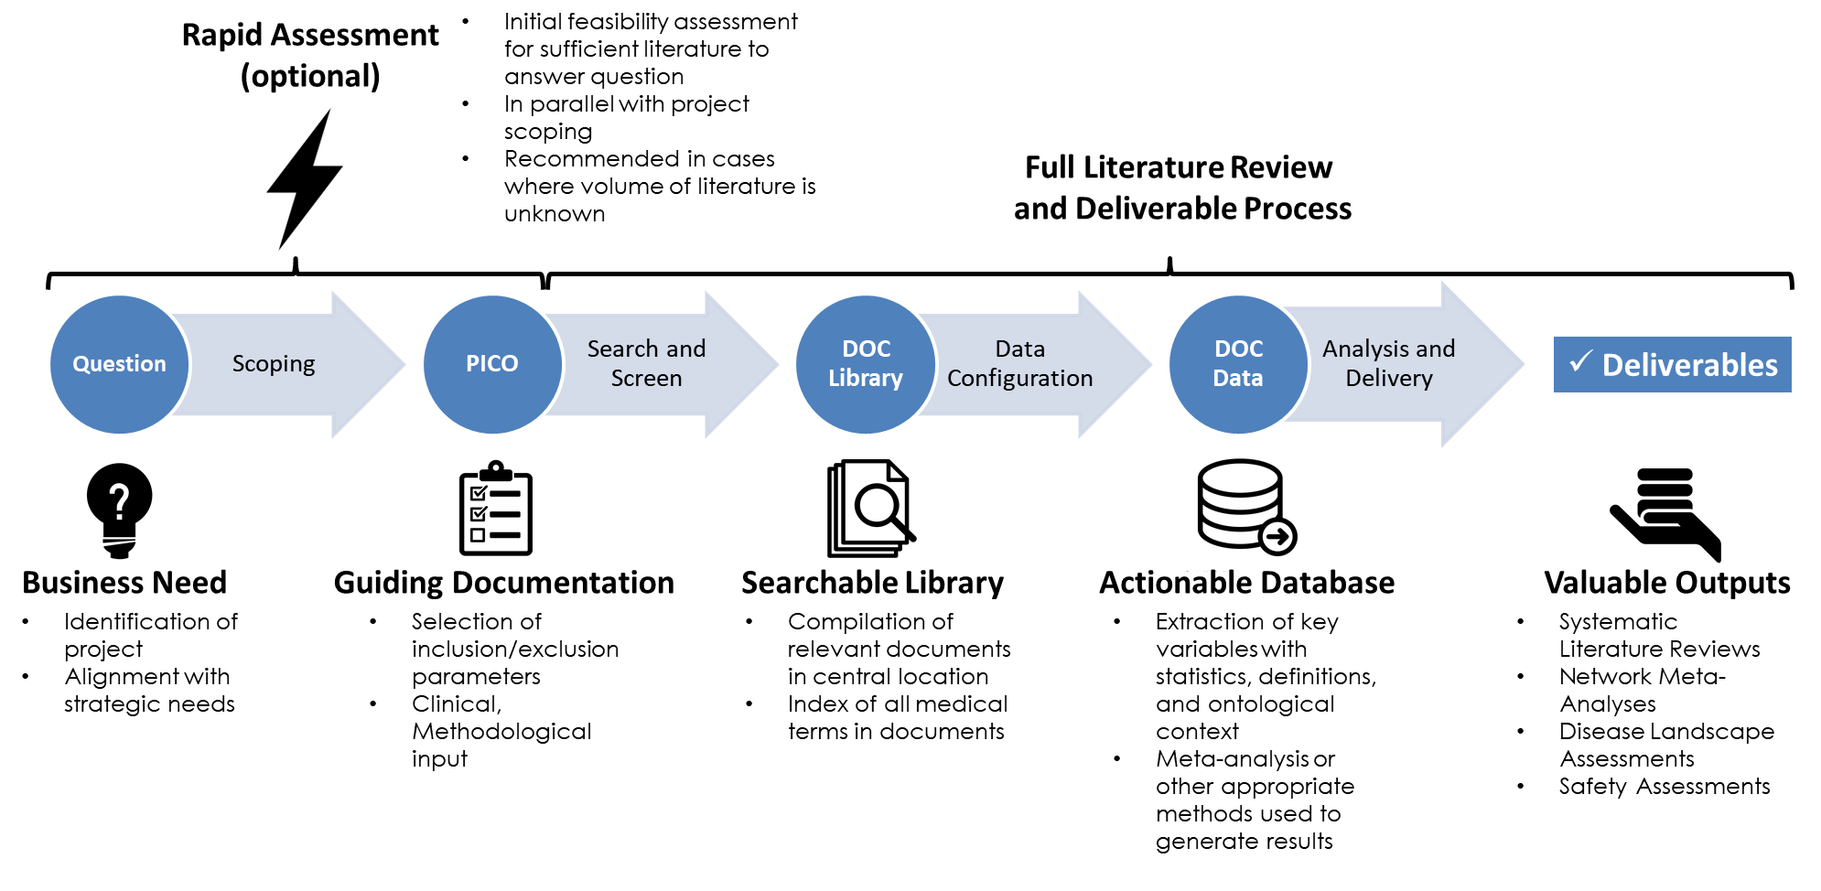
Doctor Evidence Process
DOC Search
Size & Feasibility

Slide 6



Doctor Evidence Core Products
DOC Search & Monitor literature
Search articles over various sources: Medline, ClinTrial.gov, RSS feeds
Receive updates for new data (new literature, RSS feeds daily)
Look for trends (study design, location, population…)
DOC Library Comprehensive Literature Repository
Available now for over 30 topic areas
Covers broad range of RCT and RWE articles
Can be customized for specific needs
DOC Data Analysis and Reporting
Made available per project need
Contains digitally configured study characteristics and outcomes
Enables customized analytics per project
DOC Library and DOC Data are available through Single Sign On at https://sanofi.doctorevidence.com
Please note that Chrome is the preferred browser. Please note that we now have a help chat on the platform.
Notes:
Through the Doctor Evidence-Sanofi Master Service Agreement, Doctor Evidence offers Sanofi personnel access to the approximately 150,000 existing Sanofi studies in DOC Library.
DOC Library, Doctor Evidence’s web-based repository for literature, is available through single-sign on from the Sanofi website.
DOC Data: Access configuration of study data points in a central platform
Review and analyze any patient characteristics and outcomes
Conduct real-time analysis through a web-based interface
Meta-Analysis
Indirect Treatment Comparison
Network Meta-Analysis
Generate charts and evidence tables
There is no cost for any services or use of Doctor Evidence platforms.

Slide 7
DOC Search

Slide 8
DOC Search – AI Literature Search
The DOC Search database currently contains ~28 million articles and 1.2 million concepts (2.5 million terms).
Includes access to MEDLINE, clinicaltrials.gov, 82 specialty RSS feeds, news outlets, and drug labels.
Linkages to treatments by clinical trials registry numbers support cohort follow up, post hoc and subgroup analyses across subsequent meeting abstracts journal publications.
Natural language, machine learning and federated searches over multiple years of meeting abstracts provide additional information on co-occurrences, geographic spread, and patient characteristics.

Slide 9
DOC Search: Uses
Search
Search within and across titles & abstracts of MEDLINE, ClinicalTrials.gov, & 80+ RSS feeds
Develop comprehensive search strings from natural language search terms
Monitor
Save a set of search parameters to monitor for signal detection
Track trending topics, interventions & clinician needs
Analyze
Conduct rapid assessments of any topic area & examine trends in the available evidence
Identify research gaps
Perform focused queries based on specific inclusion criteria
Sort by safety, efficacy, prevention, diagnosis, screening, therapy, prognosis, care management, etc.
Filter for specific topics, authors, interventions, patient characteristics
Identify post hoc analyses or additional research based on same clinical trial
Set signals for literature surveillance & receive notifications when new articles are published
Summarize gender, age, & geographical distributions of populations across abstracts
Identify co-occurring concepts & reliable synonym lists
Determine distribution of interventions relative to target patient profiles
Identify ontology & taxonomy mappings from natural language search terms
Determine representation of target drug/molecule, adverse events

Slide 10
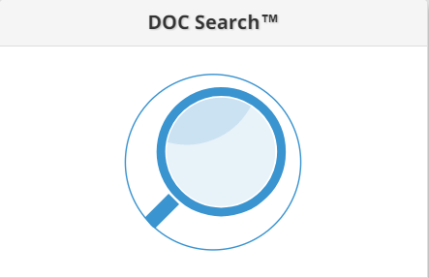
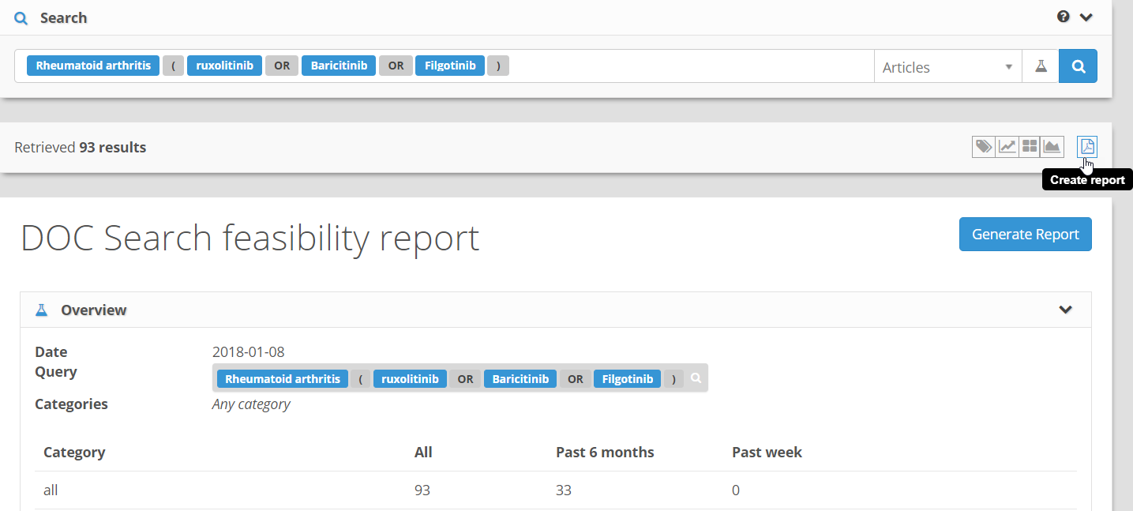
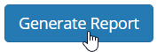
ACTIVITY – Rapid Feasibility Assessment
Log in to DRE through single-sign on: https://sanofi.doctorevidence.com
Enter your Sanofi credentials and navigate to DOC Search:
2. In the Search Bar, enter a query related to your research needs.
Simply start typing relevant terms into the search bar, and then select them from the suggestion list
For example:
3. Click on “Create Report” to produce a rapid Feasibility Report:
4. Press to download the rapid assessment
3
4

Slide 11
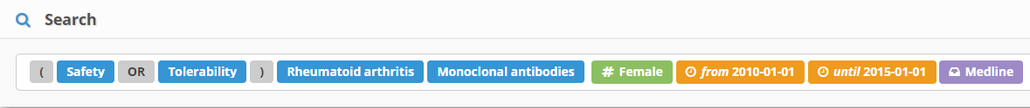
ACTIVITY – Optimizing Search Queries
Create an “Articles” search query that fits the following parameters:
Topic Area: Safety & tolerability of monoclonal antibodies in RA
Tags: Women
Date: Published after 2010 but before 2015
Sources: Medline

Slide 12
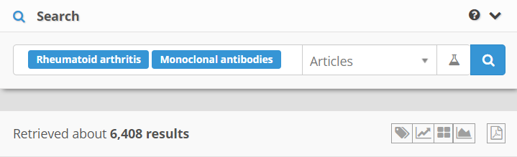
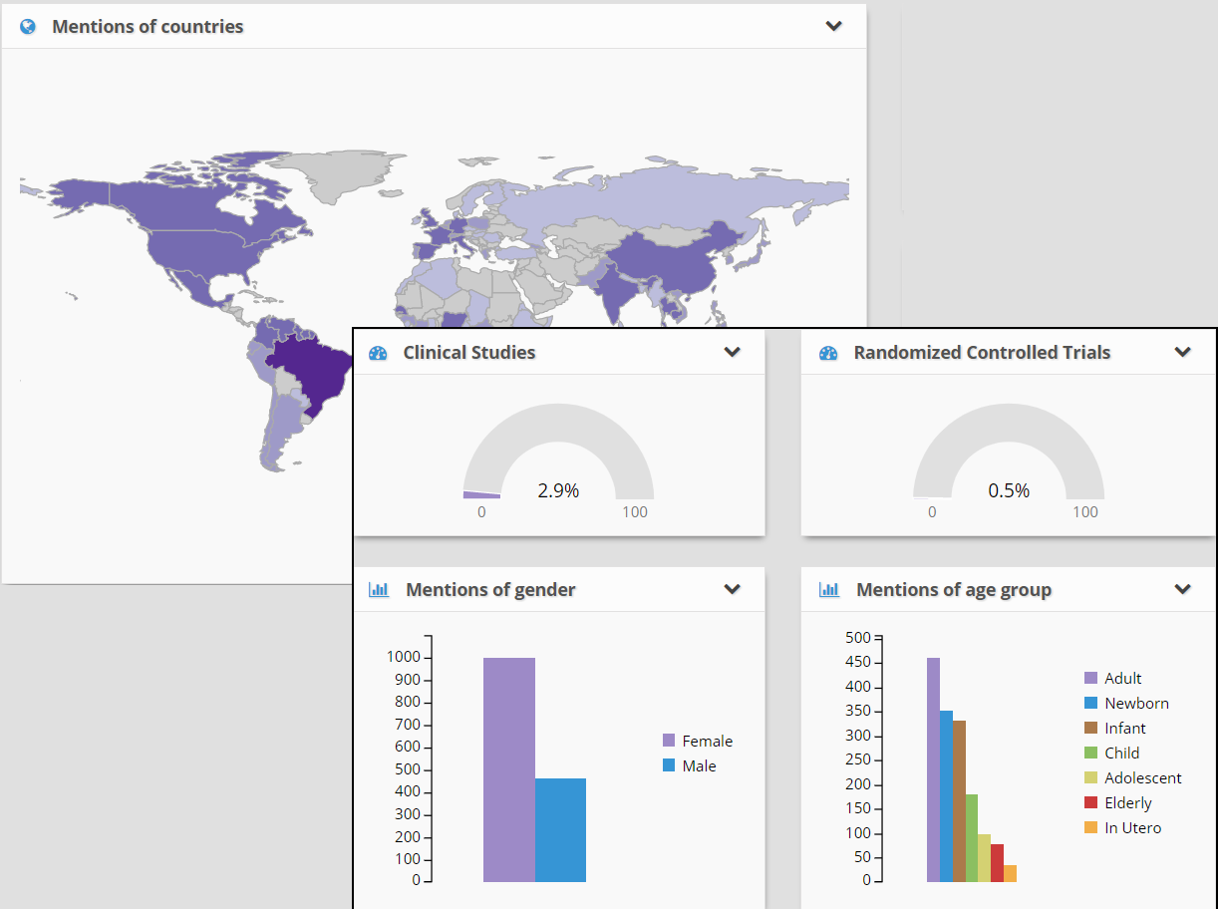
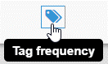
ACTIVITY – Examining Trends
Search for:
What country is most often mentioned? Which reporting tool would show that information?
Tag Frequency
Darker colors in the heat map represent the most mentions; hover for exact counts

Slide 13
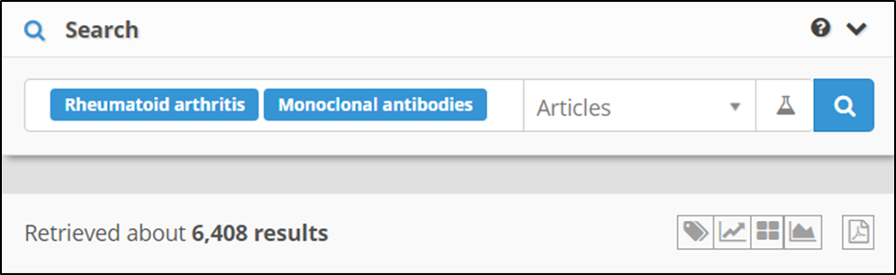
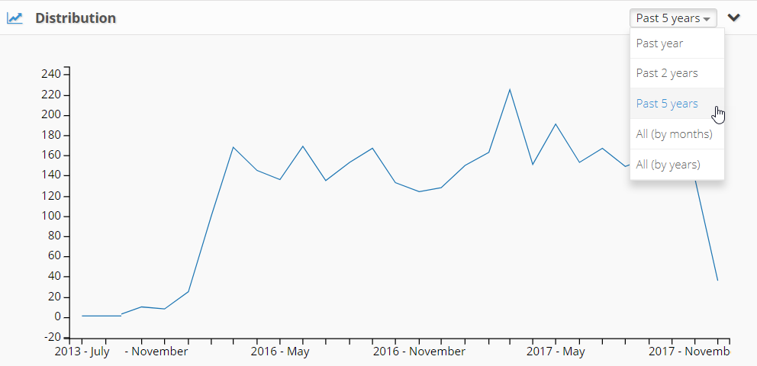
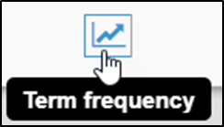
ACTIVITY – Examining Trends
Search for:
When did peak interest in this topic occur? Which reporting tool would show that information?
Term Frequency
Change the timeframe to search over the past 5 years

Slide 14

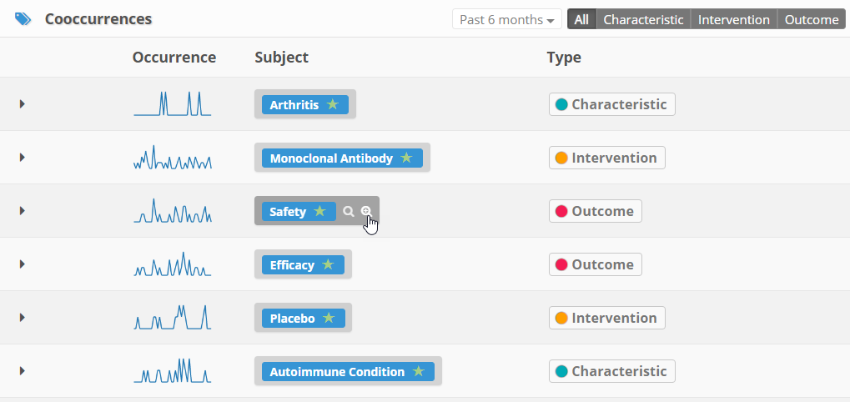

ACTIVITY – Examining Trends
Search for:
What are the most commonly associated terms for this topic area? Which reporting tool would show that information?
Cooccurrences
Add the “Safety” cooccurrence to the query by hovering the blue highlighted term and pressing ‘Add into current search query’

Slide 15
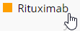
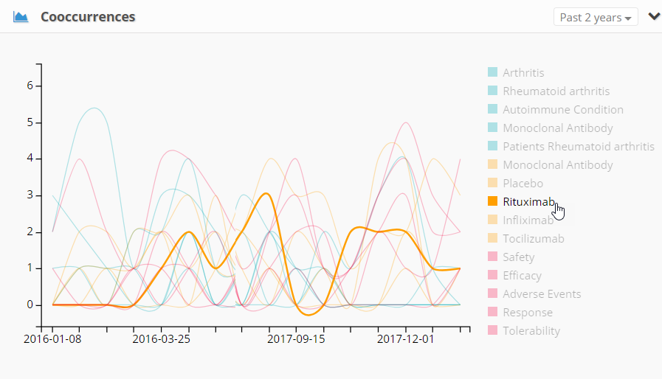

ACTIVITY – Examining Trends
Search for:
In the past 2 years, when was the term Vaccine most often mentioned? Which reporting tool would show that information?
Cooccurrences over time
Change the timeframe to 2 years, then hover over the “Rituximab” term on the right of the figure to isolate the trend line

Slide 16
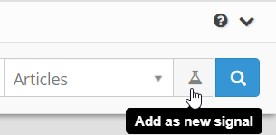
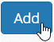
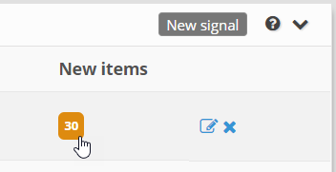
ACTIVITY – Signal Monitoring
Create your own search query on a topic of interest
Search for a topic area of interest
Specify inclusion criteria, interventions, & outcomes of interest
Use “AND”, “OR”, “NOT” operators & parentheses for grouping as needed
Use Green tags, Orange dates, and Purple sources
Enable reporting tools to examine trends in the available evidence
Tag Frequency – View mentions of country, study type, age, and gender
Term Frequency – View the distribution of evidence over time
Cooccurrences – View the associated terms; add any relevant highlights to refine your query as needed
Press ‘Add as new signal’
Enter a title for the signal (description optional) and press
Create as many signals as you would like (across topic areas), and then
sign back in to DOC Search regularly to monitor your signal for new literature

Slide 17
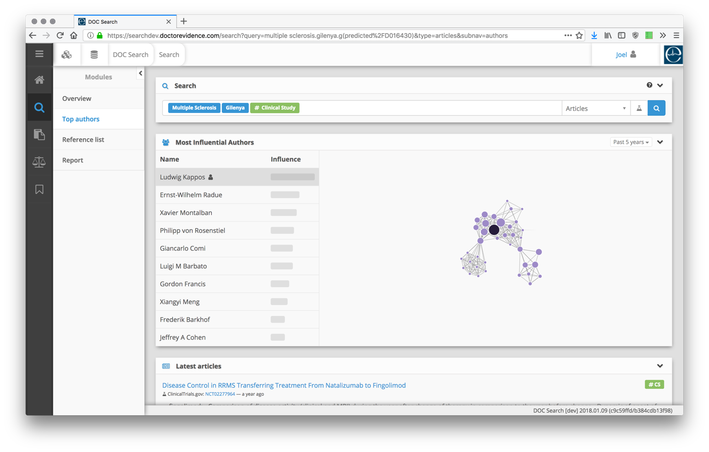
DOC Search: New Modules in Development
Author Analysis

Slide 18
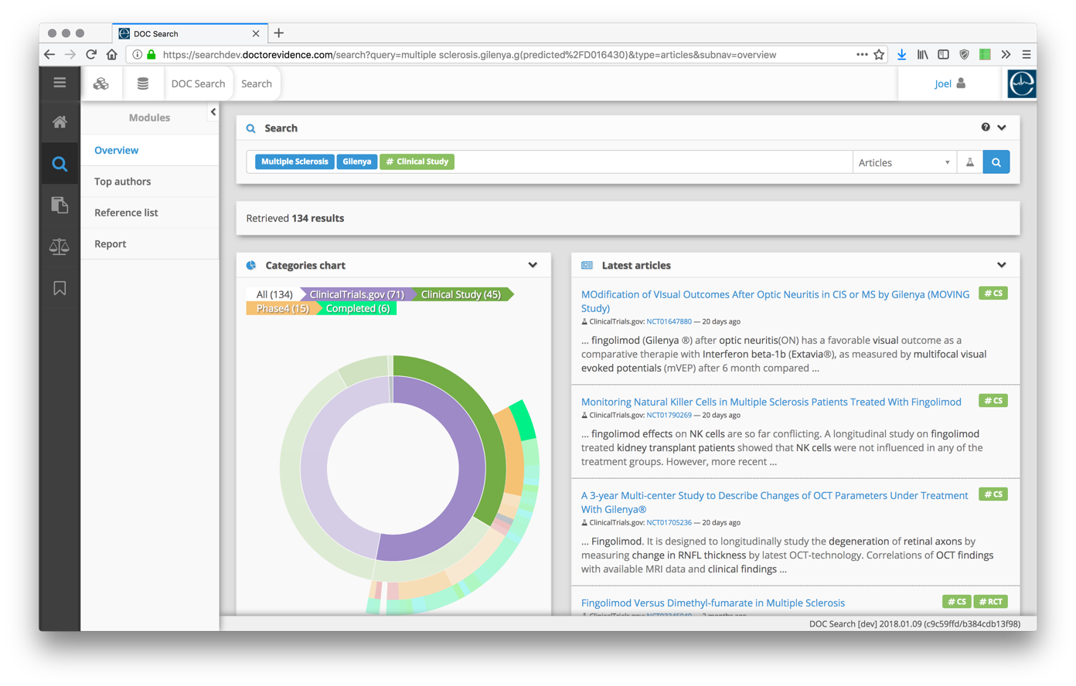
DOC Search: New Modules in Development
Categories Chart

Slide 19
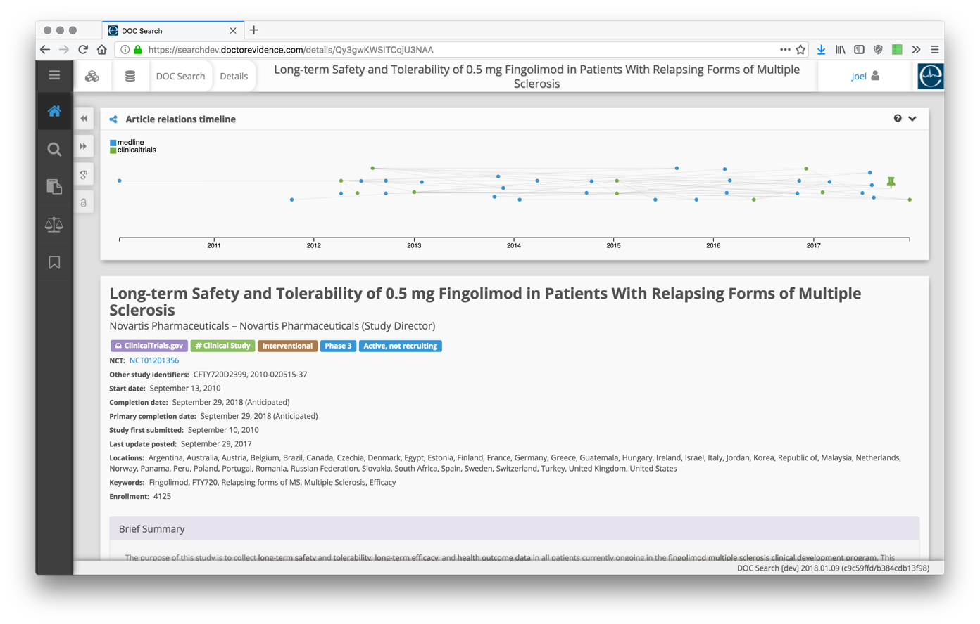
DOC Search: New Modules in Development
Article Relations Timeline

Slide 20
DOC Search: Standard Module Features
Module | Main Features | Utility
Author Analysis | Author analysis by market share and interest areas. | Ensure topic-specific expertise and broad geographic representation for key opinion leaders, guideline panelists, ad board members, clinical research experts.
Article Analysis | Abstract linkages to subsequent publications, additional analyses, systematic reviews, clinical trial registrations, and guidelines. | Track clinical trial cohorts in multiple publications, meeting abstracts, subgroup and post hoc analyses. Avoid double counting in systematic reviews. Determine inclusion or exclusion from guidelines.
Concept Analysis | Ontology and synonym analysis for treatment, disease progression, safety, and other disease-related linguistic mappings. | Meaningfully structure content, prepare comprehensive search strategies, identify appropriate synonyms and root terms.
Rapid Reviews | Perform rapid assessments of the volume of evidence from published articles and gray literature. | Early knowledge of volume of evidence base to facilitate decision-making about qualitative approaches.
Term Management | Frequency distributions of terms most frequently associated with root search terms, sorted by characteristic, intervention, and outcome. | Gain understanding of commonly occurring terms, concepts, and conditions. Inform research protocols. Identify new trending issues and safety concerns.
Literature monitoring | Select search strings to follow over time and receive alerts when new items match. | Maintain currency of evidence base and keep track of new items of interest as they are published/posted.

Slide 21
DOC Library

Slide 22
Search and Screening Process
Development of a PICO question to define the Patients, Interventions, Comparators, and Outcomes of interest
Consultations with DRE medical librarians, clinical team and methodologists
The development of a search protocol, which is converted into a unique broad search strategy
Rapid Assessment of Available Literature using DOC Search
Notes:
Every evidence project begins with the creation of a Search Protocol to determine inclusion/exclusion criteria of the search project. The process includes:
Development of a PICO question to define the Patients, Interventions, Comparators, and Outcomes of interest, which then guides the search and screening parameters to find relevant evidence.
Consultations with DRE clinical/library team, to define the PICO parameters, like study designs of interest, minimum follow-up time, minimum sample size, date ranges, etc.
A Rapid Intelligence assessment of the available literature to determine the feasibility of the project.
Based on feasibility, we can re-architect the search parameters to revise any search issues.
The development of a search protocol, which is converted into a unique broad search strategy.

Slide 23
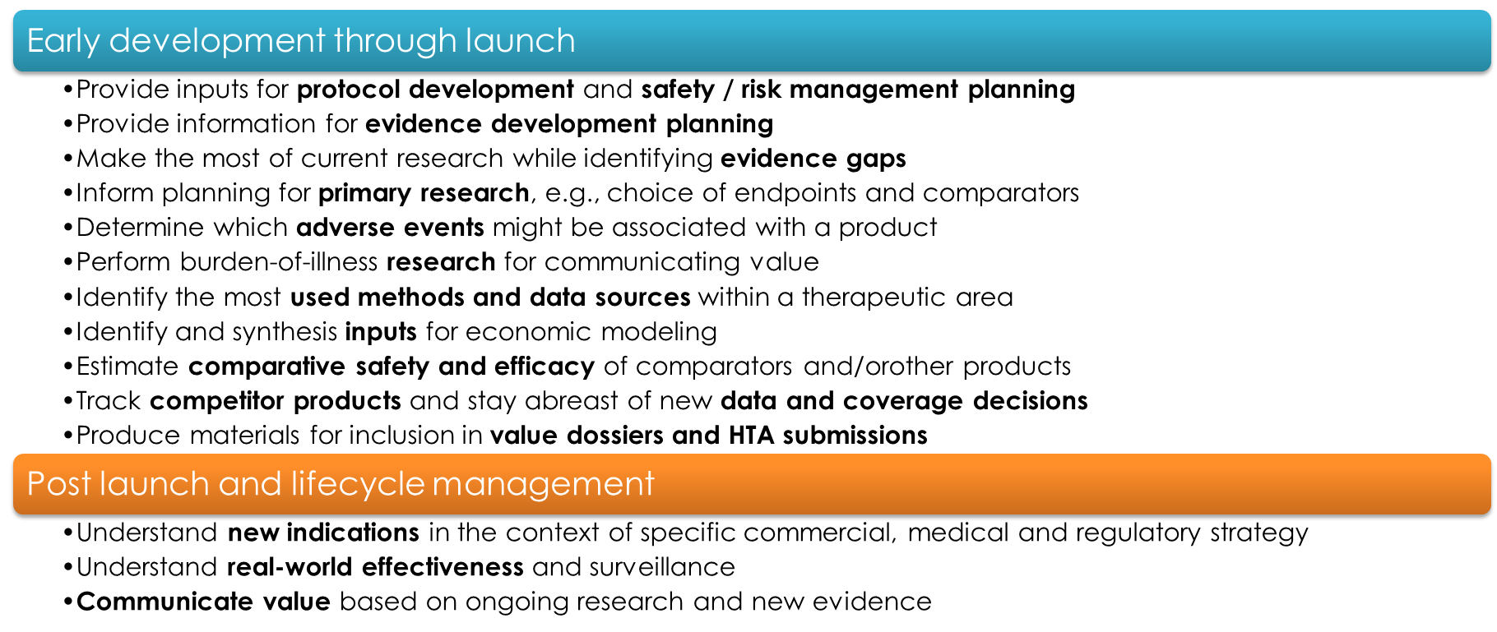
Literature Surveillance, Monthly Updates and Summaries
Notes:
Doctor Evidence Medical Librarians and Methodologists conduct tailored searches and screens to meet your exact business needs. The results of the searches are updated monthly. All assets are housed in DOC Library, Doctor Evidence’s cloud-based literature portal that stores abstracts and full-text articles in a collaborative environment.

Slide 24
Search Strategy
The search strategy includes keywords, synonyms, and MeSH terms for each of the concepts represented in the PICO.
The lead Doctor Evidence Librarian then conducts a broad search of published literature in PubMed, Embase, Cochrane and other pertinent databases.
Citations are categorized based on client needs and full-text articles are retrieved.
All full-texts are re-evaluated for eligibility by the Methodology Lead.
Reliability of the screening is confirmed by both technological and quality assurance processes within the DOC Library environment, overseen by Doctor Evidence’s CMO.
Notes:
Search strategy includes keywords, synonyms and Mesh terms for concepts in PICO
Librarians search PubMed, Embase, Cochrane and other pertinent databases
Citations are categorized based on your needs
Methodology Lead re-evaluates full-texts for eligibility
We do use some technological enhancements—also quality assurance Processes ensure right studies included in your final Evidence Project

Slide 25
Advanced Technologies to Ensure Retrieval of Relevant Articles
Pattern recognition (i.e., color coding, bolding, etc.) for ability to quickly confirm study design and/or parameters.
Keyword recognition: ability to quickly identify the relevant studies by using tools to find relevant terms/phrases in titles, abstracts and full text.
Correction and/or re-categorization of studies due to inaccuracies found in MeSH descriptors and PubMed filters.
NLP/Machine learning: increasing reliance on technologies that help automate the correct identification and categorization of references.
Quality control program to efficiently audit included and excluded references to ensure that search results have maximized retrieval of relevant references and minimized retrieval of any irrelevant references (maximize accuracy).
Notes:
These technologies, combined with the expertise of Doctor Evidence’s librarians, ensure finding more relevant studies in a timely manner.

Slide 26
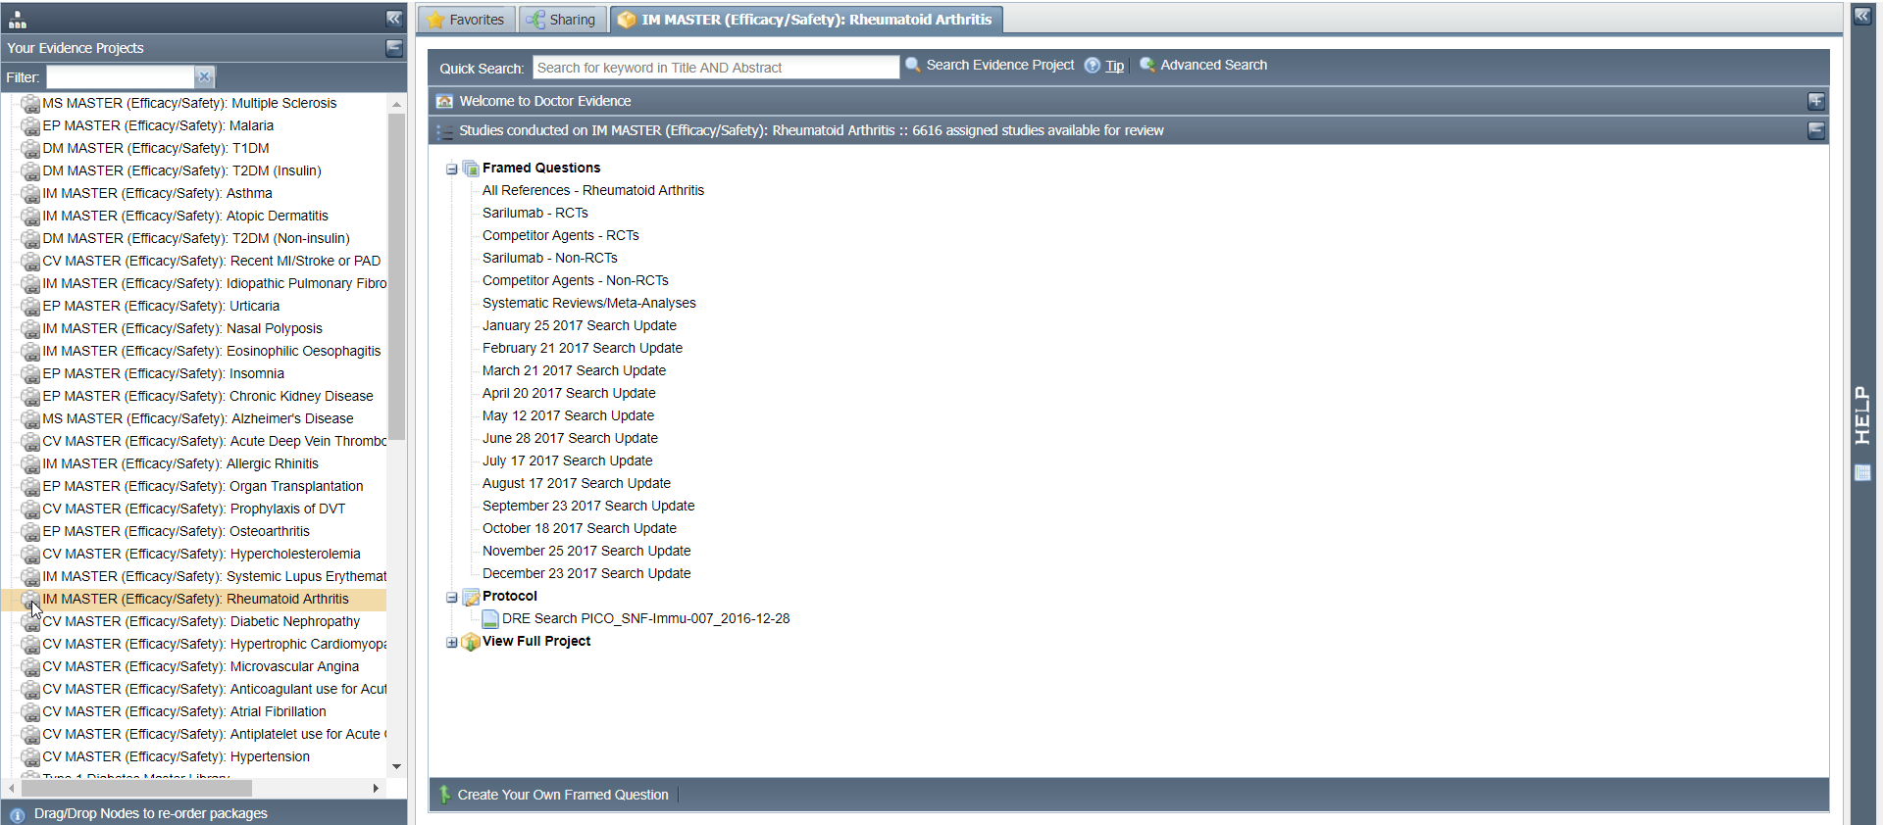
DOC Library Interface – Evidence Project
Search for your library of interest
Expand the Evidence Projects menu to switch between library packages
Literature is organized by framed question, partitioning by intervention and study design
Libraries are updated on a monthly basis
Download and review the search protocols

Slide 27
Activities
1. Expand the Evidence Projects menu 2. Navigate to the Evidence Package “IM MASTER (Efficacy/Safety): Rheumatoid Arthritis” to view the broad master library that contains all RA-related literature 3. Download the PICO specification document to view the search and screening protocol that defined this library 4. Open the “Sarilumab – RCTs” Framed Question to view the reference list of Randomized Controlled Trials
Log in to DOC Library https://sanofi.doctorevidence.com

Slide 28
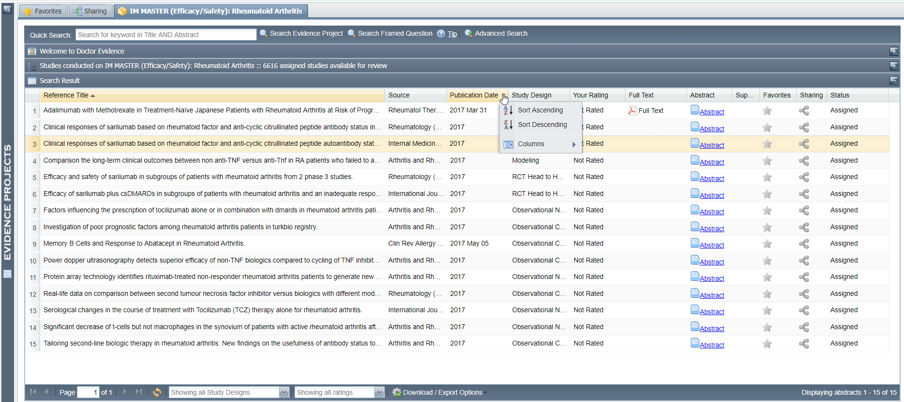
DOC Library Interface – Framed Question
Conduct advanced searches across titles, abstracts, and full text PDFs
Click on column headers to sort alphabetically, or add/remove additional columns of meta-data
Open a reference abstract to review, rate, and annotate
Export bibliography in either Reference Manager (RIS), Word document, or Excel format

Slide 29
Activities
5. Use the ‘Advanced Search’ feature to find the references report: RF+ or "Rheumatoid Factor positive" 6. Export the reference list to either Reference Manager (RIS), Excel, or Word document format 7. View an abstract and rate it as Relevant 8. Open the Notes tab of the abstract view and add a new note 9. Share the abstract with nmorgan@doctorevidence.com
Log in to DOC Library https://sanofi.doctorevidence.com

Slide 30
DOC Data

Slide 31
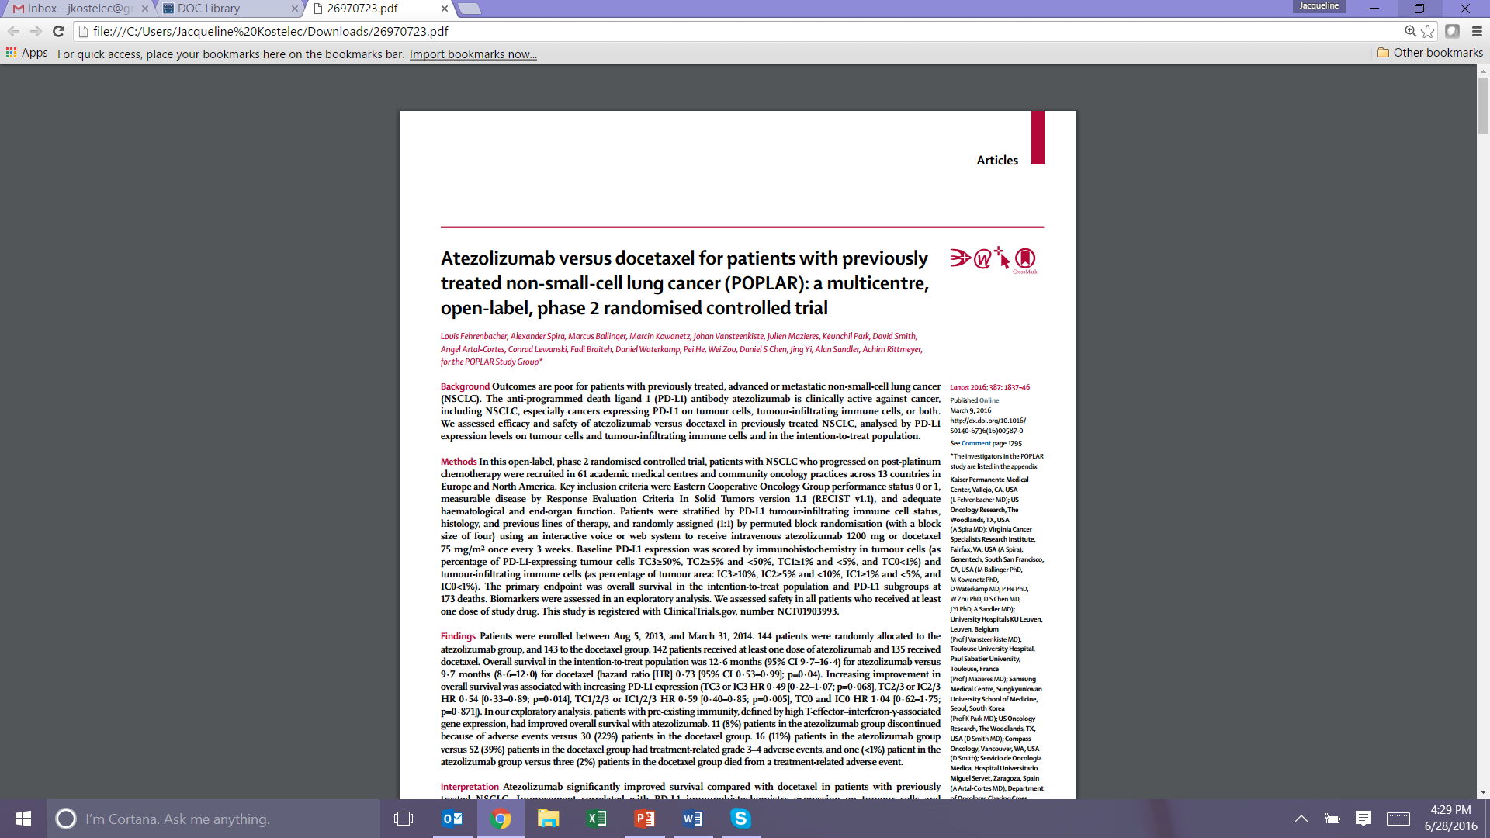
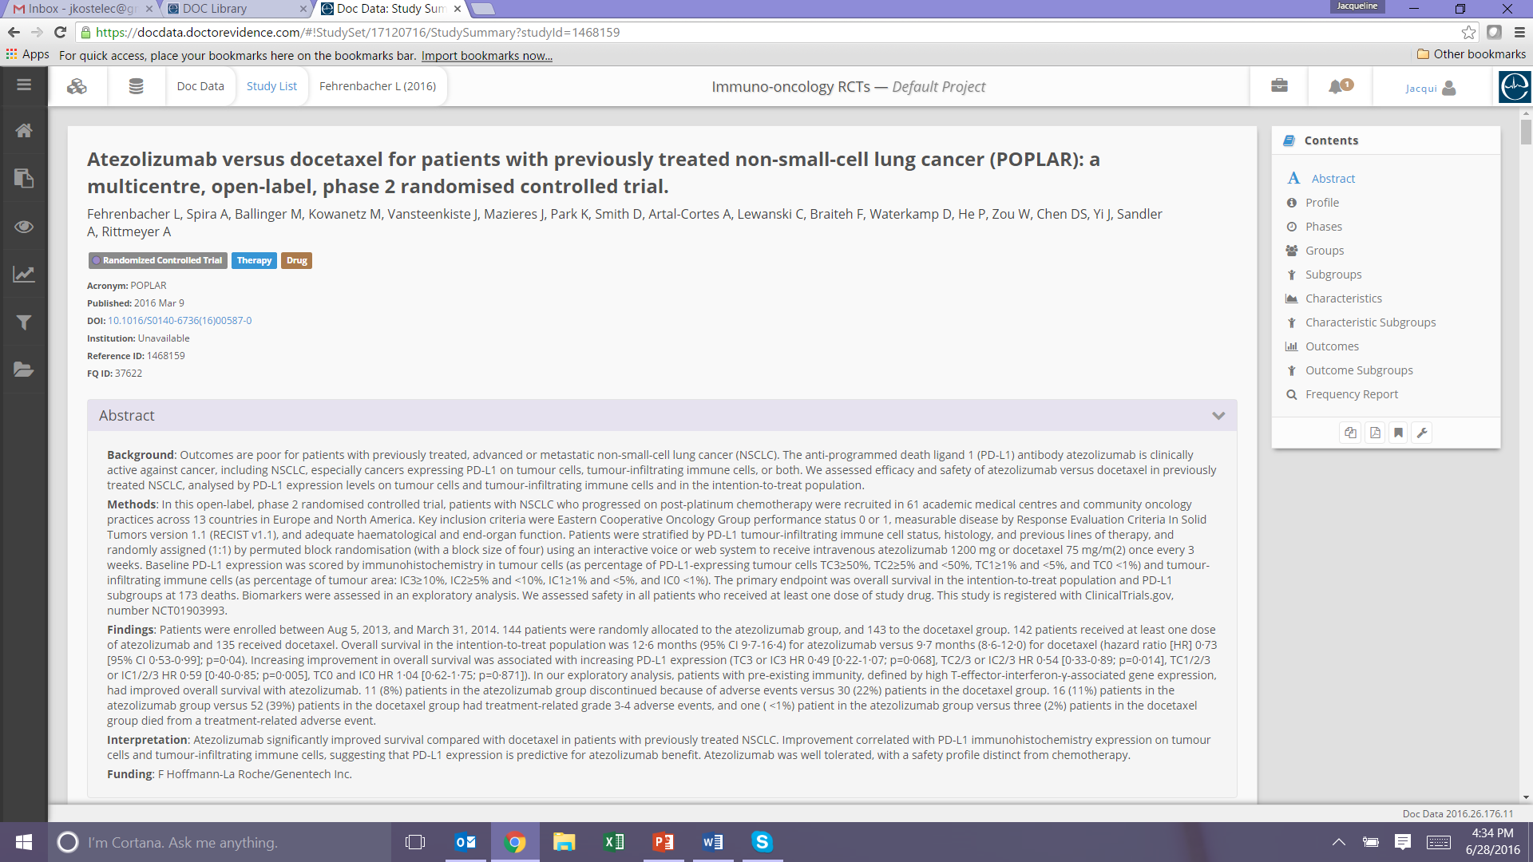
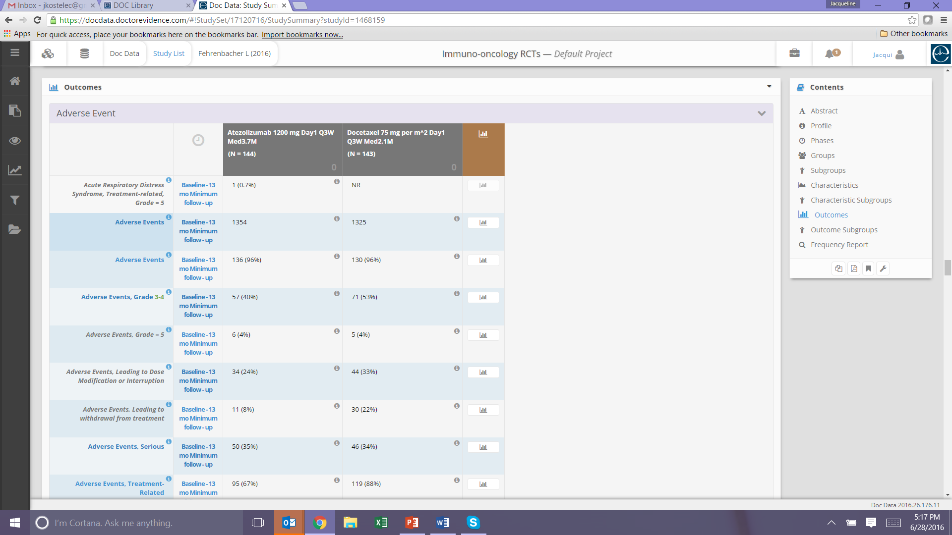
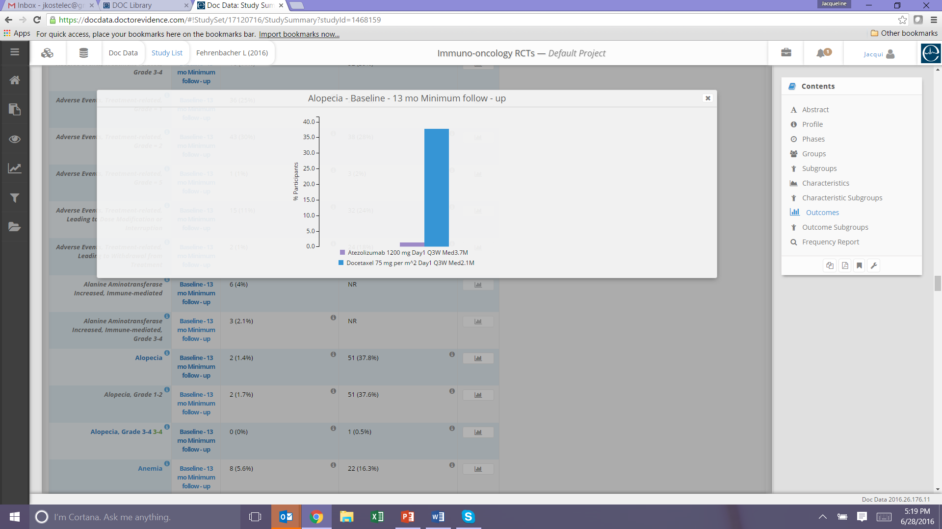
Data Digitization into DOC Data

Slide 32
Data Configuration Process
Data Configuration Protocol
Study Level Variables
Intervention variables
Data Extraction
Data and meta-data from text, tables, figures, charts
Quality control
Ontology Management
Preservation of exact term
Patient characteristics and outcomes
Consistent naming conventions
Code mapping to health language dictionaries

Slide 33
Joint DRE-Sanofi Workflow Process
 | Business Question | PICO Protocol | Literature Search and Screen | Review of Library Results | Data Configuration | Analysis and Interpretation
DRE Process |  | Joint collaboration to draft PICO Protocol | DRE conducts literature search and screen into DOC Library | Joint review of search results | DRE conducts data configuration into DOC Data | DRE and/or Sanofi produce analytics
Sanofi Process | Sanofi submits business question
Workflow Process from Beginning to End

Slide 34
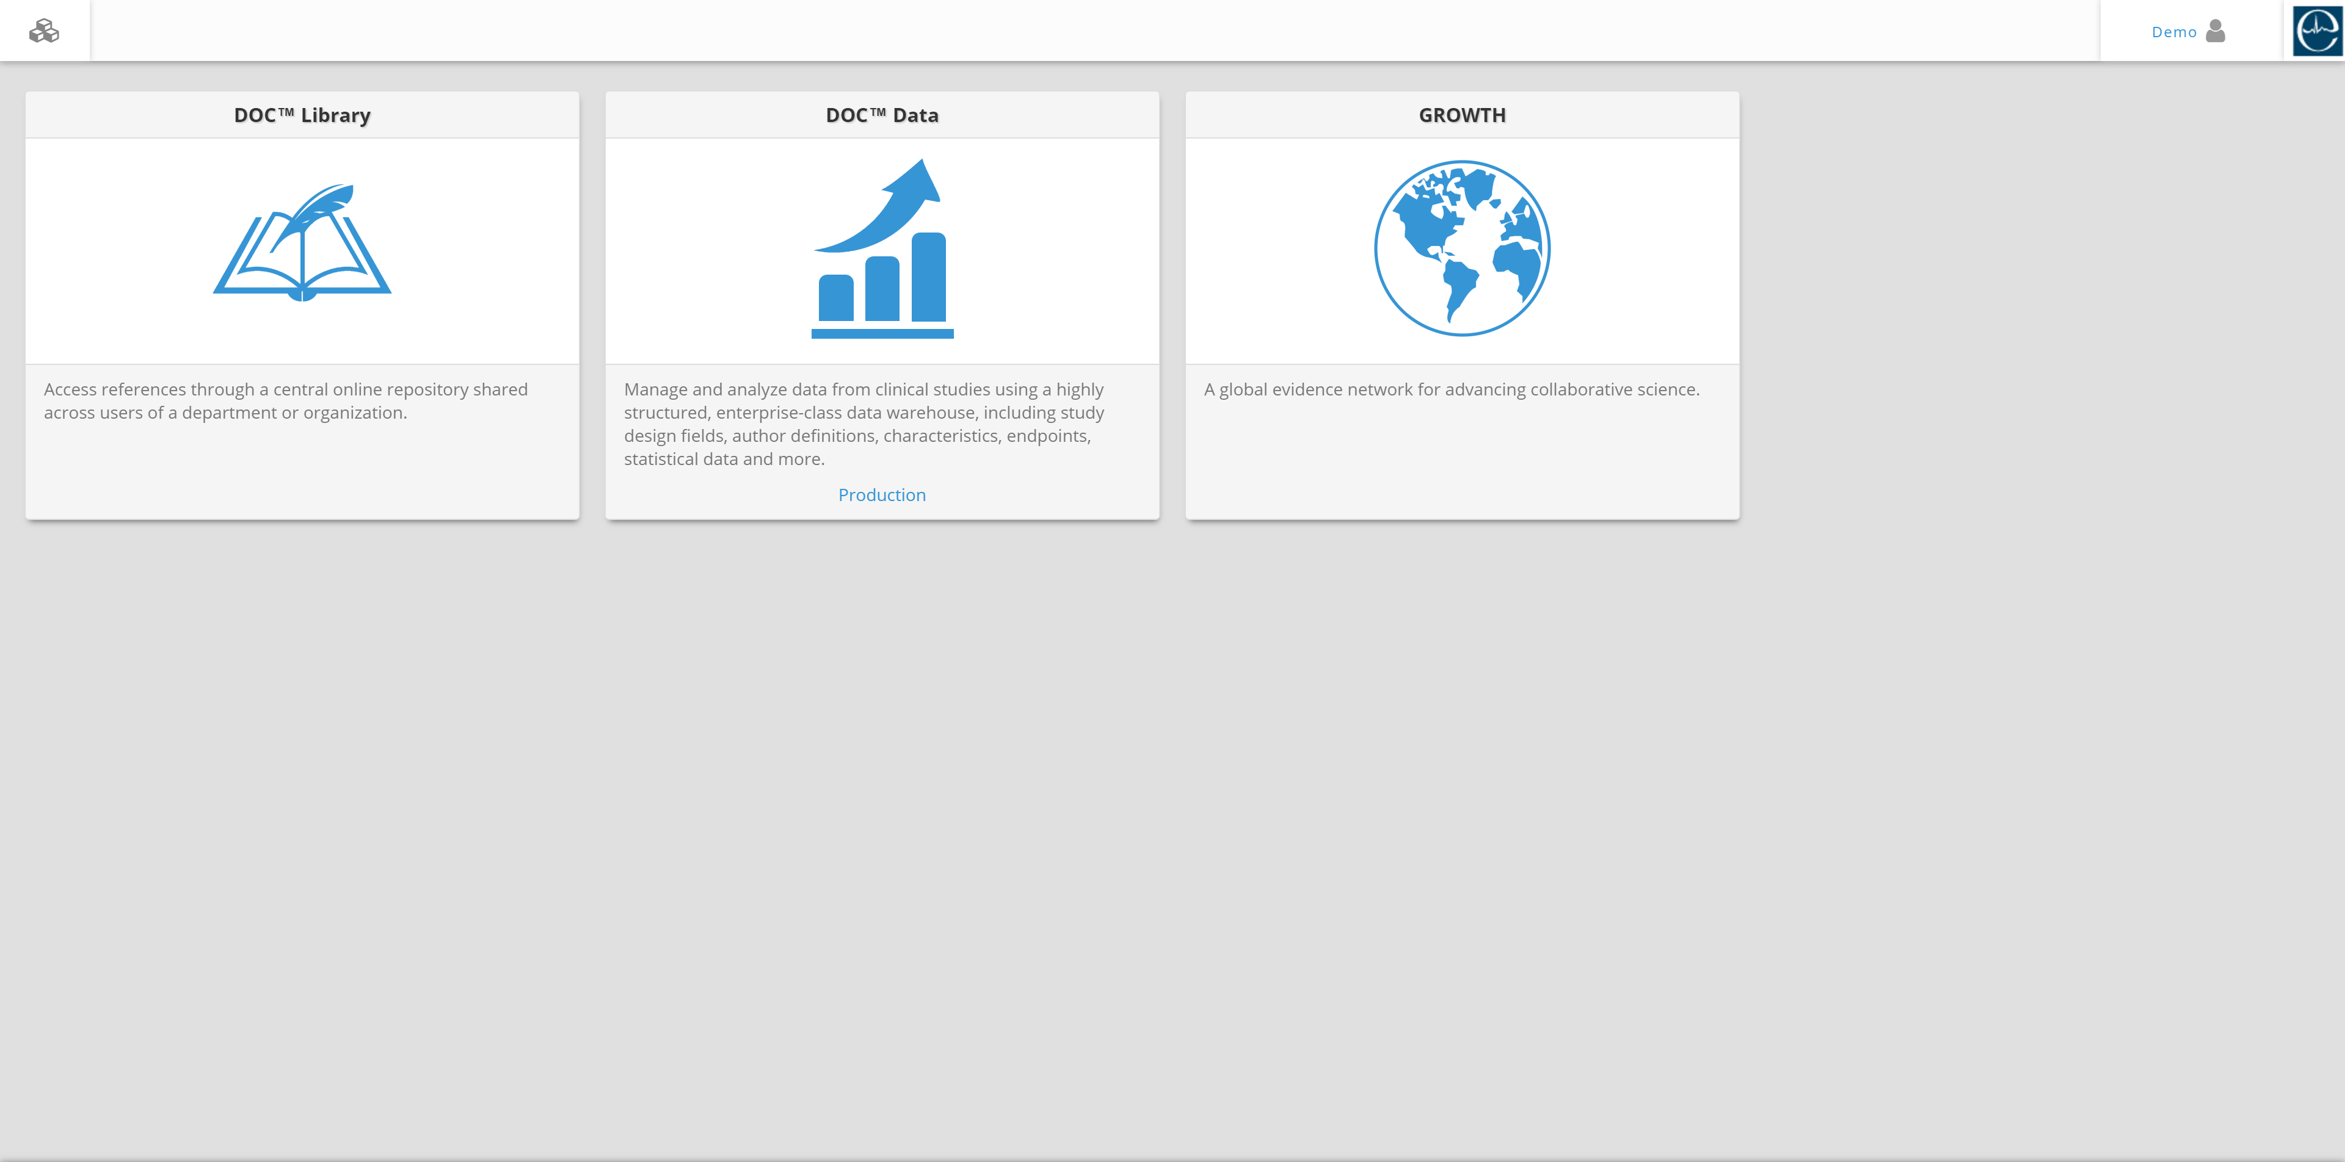
DOC Data Navigation: ALLOWS YOU TO LAUNCH ANY DOC APPLICATION
To log in to DOC Data, navigate to
https://sanofi.doctorevidence.com.
Please note that Chrome is the recommended browser.

Slide 35



DOC Data: Task-Tool Matrix
Tools | Task | Understand body of evidence | Explore individual studies | Examine comparative efficacy/ safety | Answer epidemiology question | Explore heterogeneity | Conduct sensitivity analysis | Save & reuse work
Home page
Study List
Data Export Tool
Evidence Table Wizard
Analysis: Direct Meta
Analysis: Freq. NMA
Analysis: Bayesian NMA
Analysis: Cohort

Slide 36


DOC Data: Task-Tool Matrix
Tools | Task | Understand body of evidence | Explore individual studies | Examine comparative efficacy/ safety | Answer epidemiology question | Explore heterogeneity | Conduct sensitivity analysis | Save & reuse work
Reports: Term Index
Reports: EOD
Reports: “Other”
Evidence Value Statements
Workflow Management
Study Summary
Bubble Chart
Parallel Axis Chart
Filters

Slide 37
Training Curriculum
Introductory Training
45-minutes, via webinar or self-paced online.
Rapid Assessment Training
(DOC Search)
1. Introductory
2. Advanced
Intermediate Training Modules
(Doc Data)
1: Reviewing Library Packages
2: Reviewing a Body of Evidence
3: Exporting Data for Deliverables
4: Conducting Analyses
Advanced Training
3-hour on demand, face-to-face workshop to become fully proficient in using DOC Data
For training information, please contact sanofi.support@doctorevidence.com
Notes:
Doctor Evidence conducts regularly scheduled trainings on the use of their platforms, including DOC Search, DOC Library, and DOC Data. Please contact Doctor Evidence directly to initiate your own project and take advantage of the cutting-edge technology and services available to you.

Slide 38
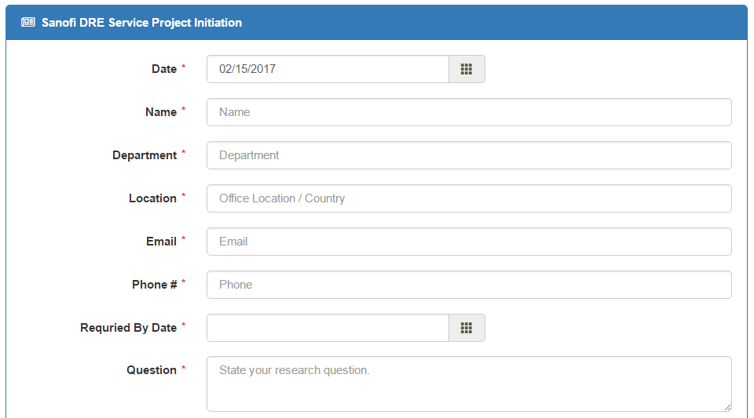
Requesting a Customized Library Package
https://reports.doctorevidence.com/pages/Client/ServiceProject.aspx
Notes:
You can request a library package, or assistance with any other type of project, in several ways: You can complete this online form, which will be emailed to you after this presentation.

Slide 39
Initiating a Project – Additional Contact Info
Michael del Aguila
SVP, Client Solutions
mdelaguila@doctorevidence.com
+1 973 900 1172
Toby Sayre
VP, Consulting Services
tsayre@doctorevidence.com
+1 707 303 6759
Jean-François Bitsch
Director, Client Solutions, France
jfbitsch@doctorevidence.com
+33 6 10 42 46 87
Notes:
You can also contact our client and consulting services team members, Michael del Aguila, Toby Sayre or Jean-Francois.

